Slide 1
VR 360° Player
Hezi Banda & Alexey Khromov Supervised by Arye Albahari & Aviel Nahum
CGM Winter 2018

Slide 2
Agenda
Motivation
VR challenges
Player concept
SDKs
Architecture
Profiling
Demonstration
Future work

Slide 3
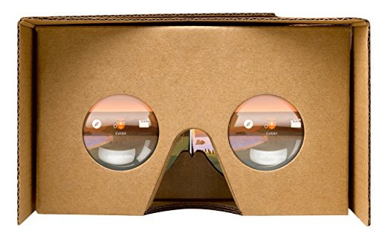
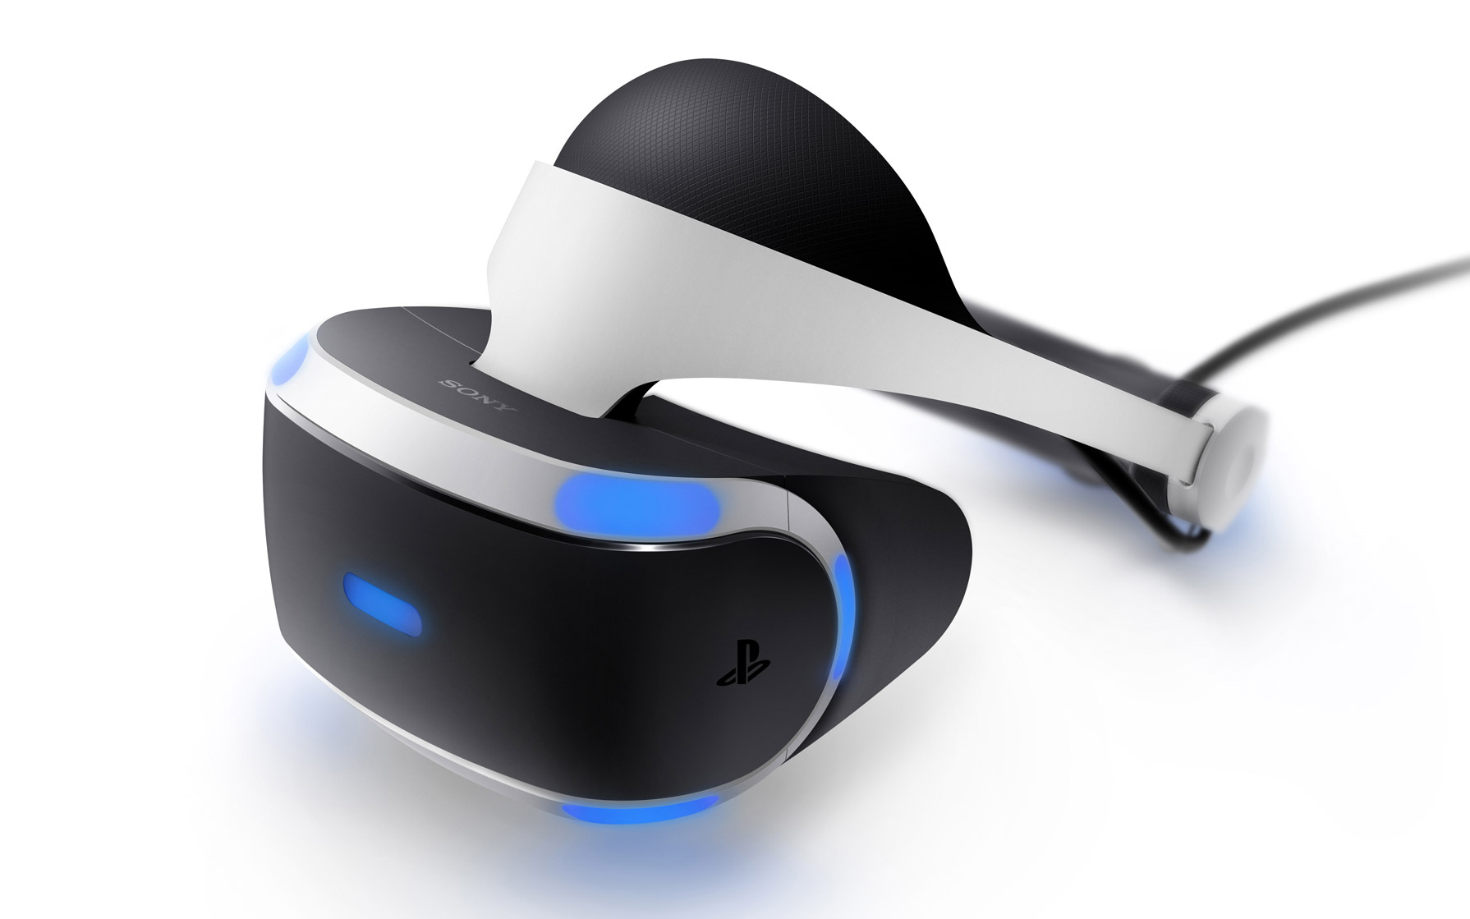
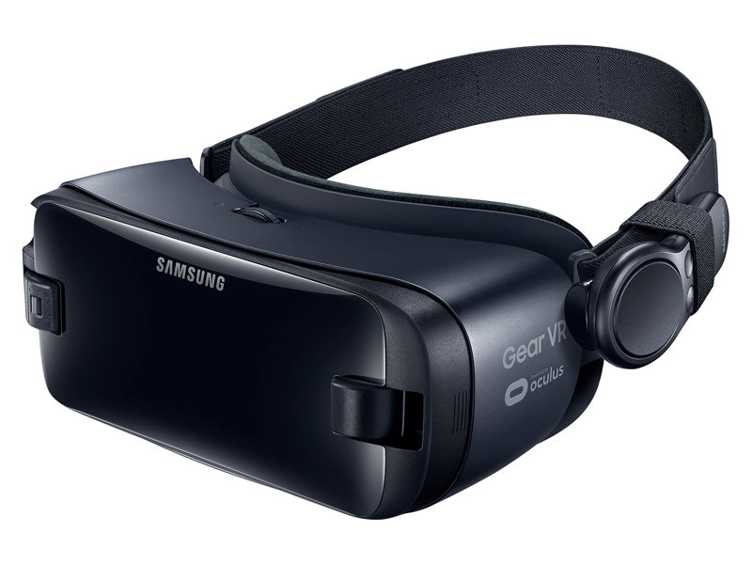
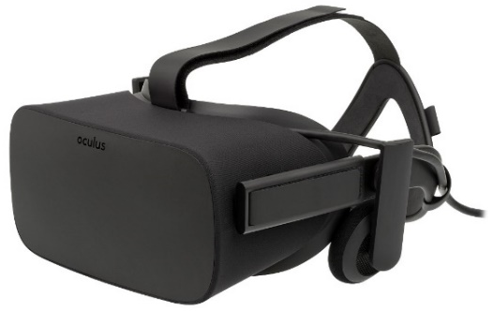
Motivation
VR is a growing industry
2014: Google launches an affordable VR headset
2015: Facebook acquires Oculus for $2 billion
2015: YouTube & Facebook add support for 360° Video technology
…
2018: Hezi & Alexey develop an open-source VR 360° Player

Slide 4
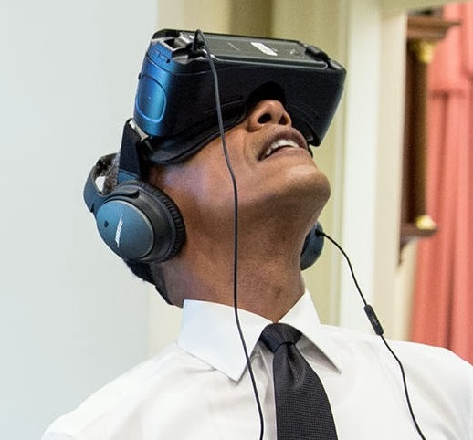
VR Challenges
VR demands strong hardware and application support
High refresh rate ( 90 Hz ) – How to handle movies?
Double rendering ( once per eye )
High resolution ( 1080x1200 X2 )
Wide FOV ( 110° )
Quality sensitivity
Low motion-to-photon latency ( <11 ms )
Power consumption

Slide 5
Player concept
Input: encoded video file, e.g. surprise.mp4
Output: render the video in 360° to Oculus Rift
Method: Deploy a sphere and project frames onto it, use low level API to achieve performance
Immersive experience
Optional: add UI features
Read bytes
Decode a frame
Project on a sphere
Submit to headset

Slide 6
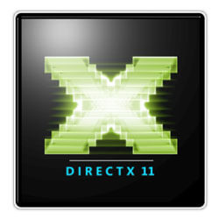
SDKs – DirectX 11
Microsoft’s graphics API
Low level access to hardware for multimedia purposes
Device, context, swap chain, texture, etc.
DirectXTK – DirectX Toolkit. Used for rendering the sphere
Notes:
Why not OpenGL ?

Slide 7
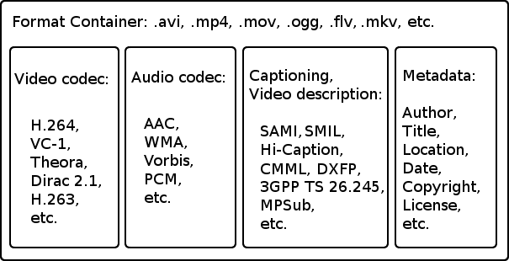

SDKs – FFmpeg
Cross platform, Open source, GPL project
Used for demuxing (שליפה) the video elementary stream from standard containers
Notes:
In the future – will demux also audio

Slide 8

SDKs – Intel Media SDK
Provides API for performing hardware accelerated video decoding on gen. 6+ Intel processors
Faster than software decoding
Energy efficiency
Contains samples and tutorials
The player is built on top of the decoding sample

Slide 9
SDKs – Oculus + Runtime
Provides the means for communicating with Oculus Rift
The Runtime connects between the application and the driver, and provides services the following services:
Lens distortion
Time Warp
Notes:
The means = LibOVR

Slide 10
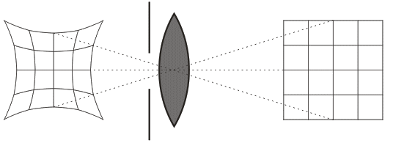
SDKs – Oculus + Runtime
Provides the means for communicating with Oculus Rift
The Runtime connects between the application and the driver, and provides services the following services:
Lens distortion
Lens distortion
Notes:
The means = LibOVR

Slide 11
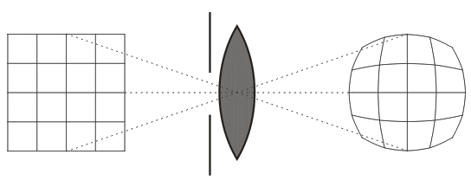
SDKs – Oculus + Runtime
Provides the means for communicating with Oculus Rift
The Runtime connects between the application and the driver, and provides services the following services:
Lens distortion
Lens distortion
Notes:
The means = LibOVR

Slide 12
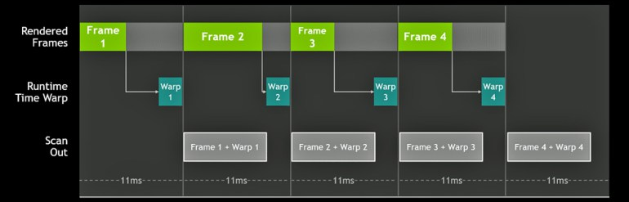
SDKs – Oculus + Runtime
Provides the means for communicating with Oculus Rift
The Runtime connects between the application and the driver, and provides services the following services:
Time Warp (improves motion-to-photon latency)
Ideal VR Pipeline
Notes:
The means = LibOVR

Slide 13
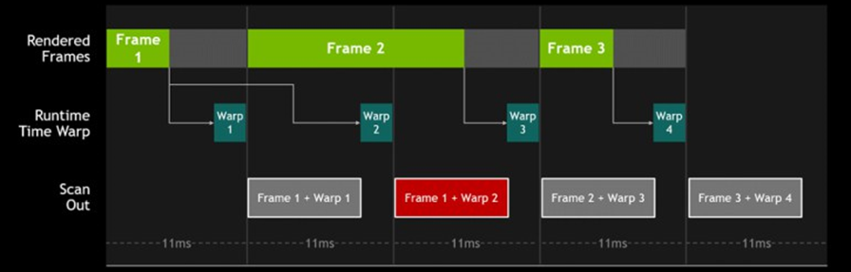
SDKs – Oculus + Runtime
Provides the means for communicating with Oculus Rift
The Runtime connects between the application and the driver, and provides services the following services:
Time Warp (improves motion-to-photon latency)
Dropped Frame
Notes:
The means = LibOVR

Slide 14
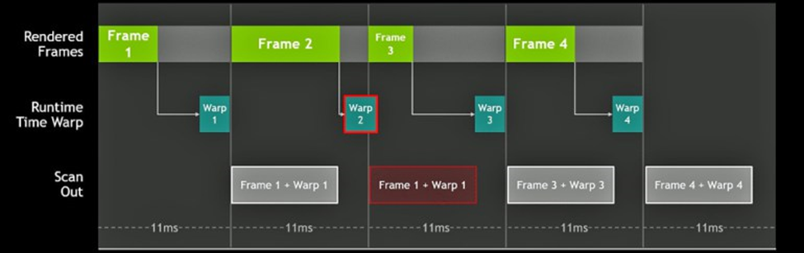
SDKs – Oculus + Runtime
Provides the means for communicating with Oculus Rift
The Runtime connects between the application and the driver, and provides services the following services:
Time Warp (improves motion-to-photon latency)
Warp Miss
Notes:
The means = LibOVR

Slide 15
Architecture – Overview

Slide 16
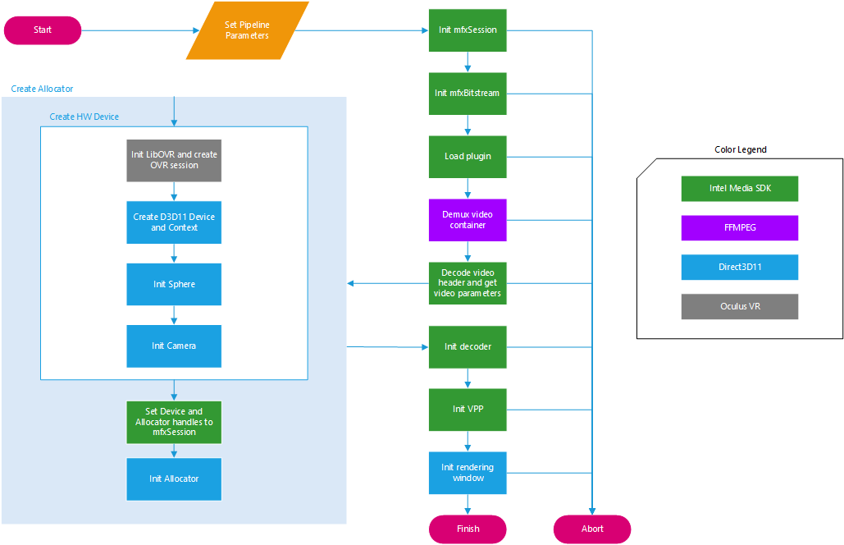
Architecture – Initialization
Notes:
Init: 0.2 sec

Slide 17
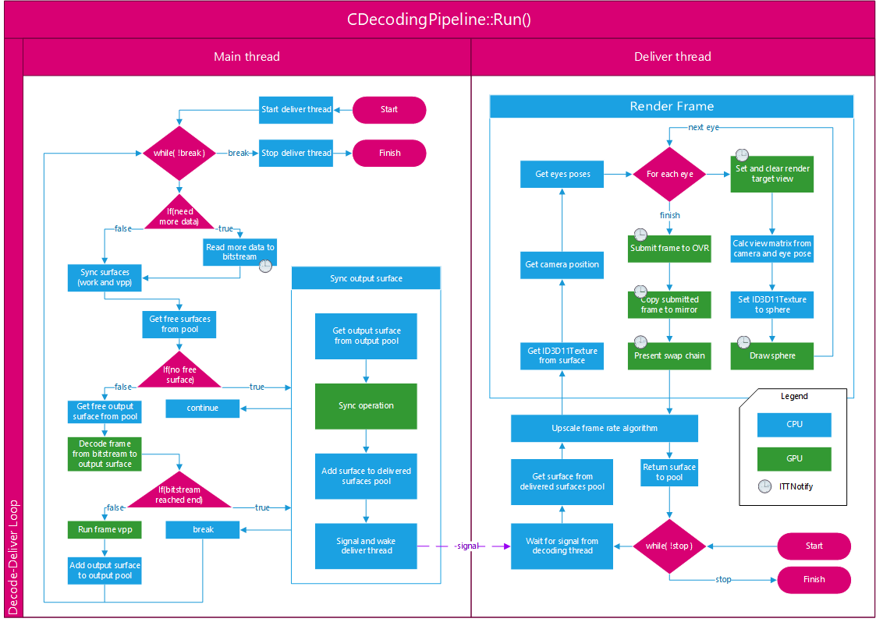
Architecture – Run

Slide 18
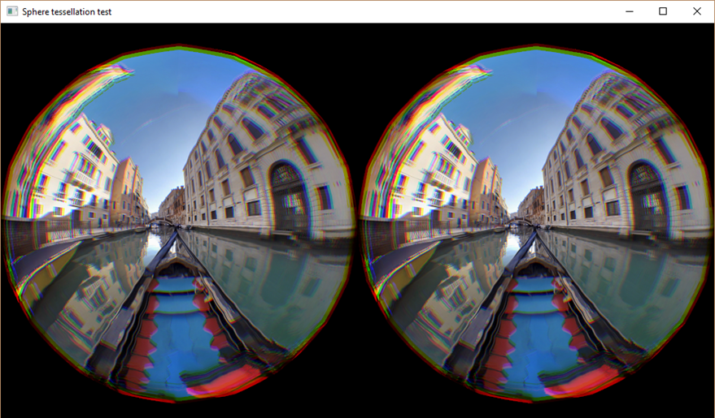
Architecture – Sphere
Deployed using DirectXTK
Tessellation parameter determines precision
Higher tessellation = higher accuracy but more rendering work
Tessellation = 3
Vertices = 277

Slide 19
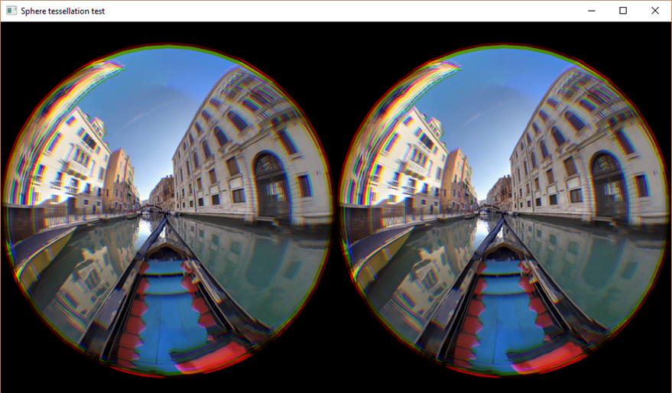
Architecture – Sphere
Deployed using DirectXTK
Tessellation parameter determines precision
Higher tessellation = higher accuracy but more rendering work
Tessellation = 4
Vertices = 1061

Slide 20
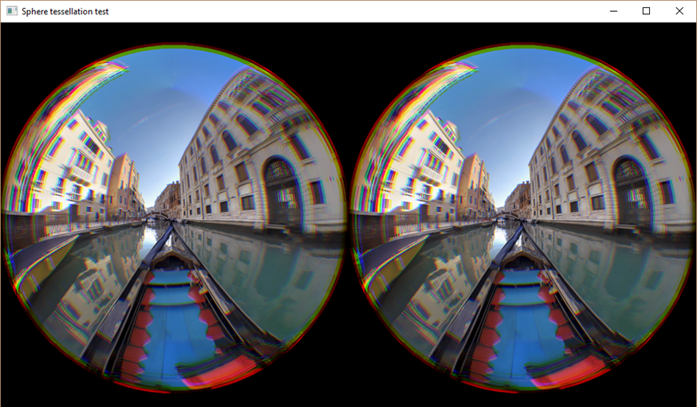
Architecture – Sphere
Deployed using DirectXTK
Tessellation parameter determines precision
Higher tessellation = higher accuracy but more rendering work
Tessellation = 5
Vertices = 4165

Slide 21

Architecture – Sphere
Deployed using DirectXTK
Tessellation parameter determines precision
Higher tessellation = higher accuracy but more rendering work
Tessellation = 6
Vertices = 16517

Slide 22
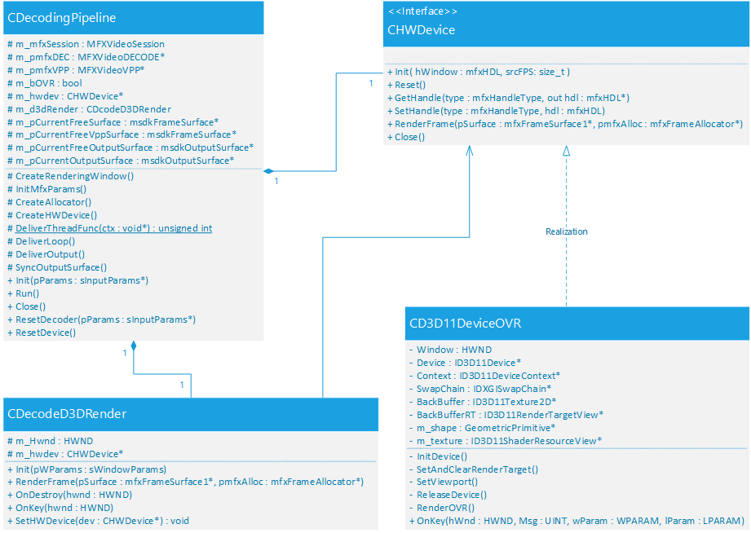
Architecture – Class Diagram

Slide 23
Frame rate conversion
Problem: video files run at a standard rate of ~(24-60) fps whereas headsets are refreshed at ~90Hz
How to convert it to the headset’s refresh rate?
How to make sure it’s not displayed too fast/slow?
Do we repeat frames? Which ones?
Notes:
השאלה עצמה לא פשוטה ויש לה הרבה פתרונות בתעשייה, חלקם מסובכים יותר וחלקם פחות. אבל אם נעזרים בכל מיני הנחות זה מצטמצם לתרגיל באלגברה

Slide 24
Frame rate conversion
Solution: An algorithm that determines which frames to repeat and how many times, optimized for “smoothness”.
Optimized for “smoothness”: The difference between the most and the least repeated frames should be no more than one repetition.
Intuition – this is considered bad outcome:
1
2
3
…
In: 45 fps
1
1
1
…
2
2
2
3
3
Out: 90 fps
This is the expected outcome

Slide 25
Frame rate conversion
Example 1 – In: 30 fps, Out: 90 fps
1
2
3
4
…
In: 30 fps
1
1
1
2
2
2
3
3
3
…
Out: 90 fps

Slide 26
Frame rate conversion
Example 2 – In: 60 fps, Out: 90 fps
1
2
3
4
…
In: 60 fps
1
2
2
3
4
4
5
6
6
…
Out: 90 fps

Slide 27
Frame rate conversion
Example 3 – In: 80 fps, Out: 90 fps
1
2
3
4
…
In: 80 fps
1
1
2
3
4
5
6
7
8
…
Out: 90 fps

Slide 28
Frame rate conversion
Example 4 – In: 40 fps, Out: 90 fps
1
2
3
4
…
In: 40 fps
1
1
2
2
3
3
4
4
4
…
Out: 90 fps

Slide 29
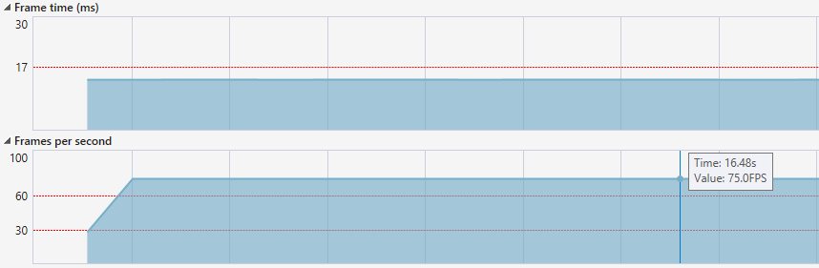
Profiling
Profiling tools:
Visual Studio Performance Profiler (High, stable performance)
Intel VTune Amplifier

Slide 30
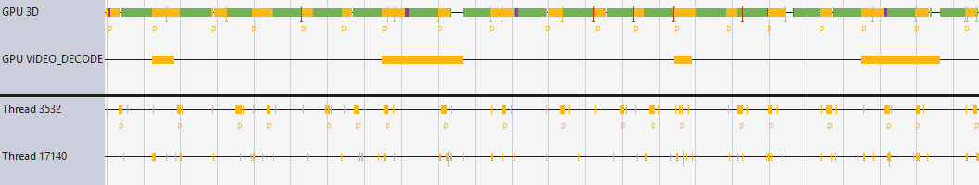
Profiling
Profiling tools:
Visual Studio Performance Profiler
Intel VTune Amplifier
Player
Runtime

Slide 31
Profiling – Render Loop (deliver th.)
Eye 1
Clear Buffers
3-10 %
Draw
3-10 %
Clear Buffers
3-10 %
Draw
3-10 %
Runtime
58-85 %
Copy Resource ~2 %
Present
< 0.1 %
Eye 2
Notes:
Init: 0.2 sec
Read data: negligible
Wait in deliver: negligible

Slide 32
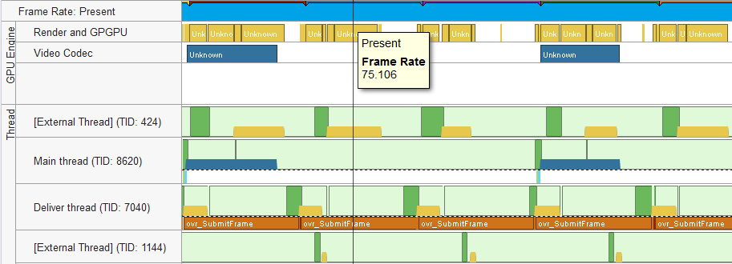
Profiling
Profiling tools:
Visual Studio Performance Profiler
Intel VTune Amplifier
Notes:
Init: 0.2 sec
Read data: negligible
Wait in deliver: negligible

Slide 33
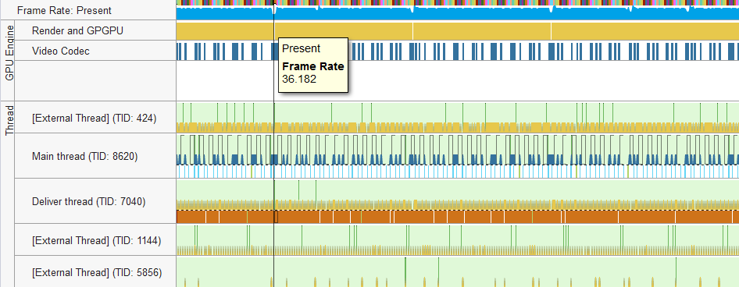
Profiling
Profiling tools:
Visual Studio Performance Profiler
Intel VTune Amplifier

Slide 34

Demonstration

Slide 35
Future work
Further investigate optimization opportunities
Add support for WinMR/HTC Vive/etc.
Add audio support
Add rewind support
Complete UI
Add seek support

